Slide 1
Chapter 11 acids and bases
Wilt Gu

Slide 2
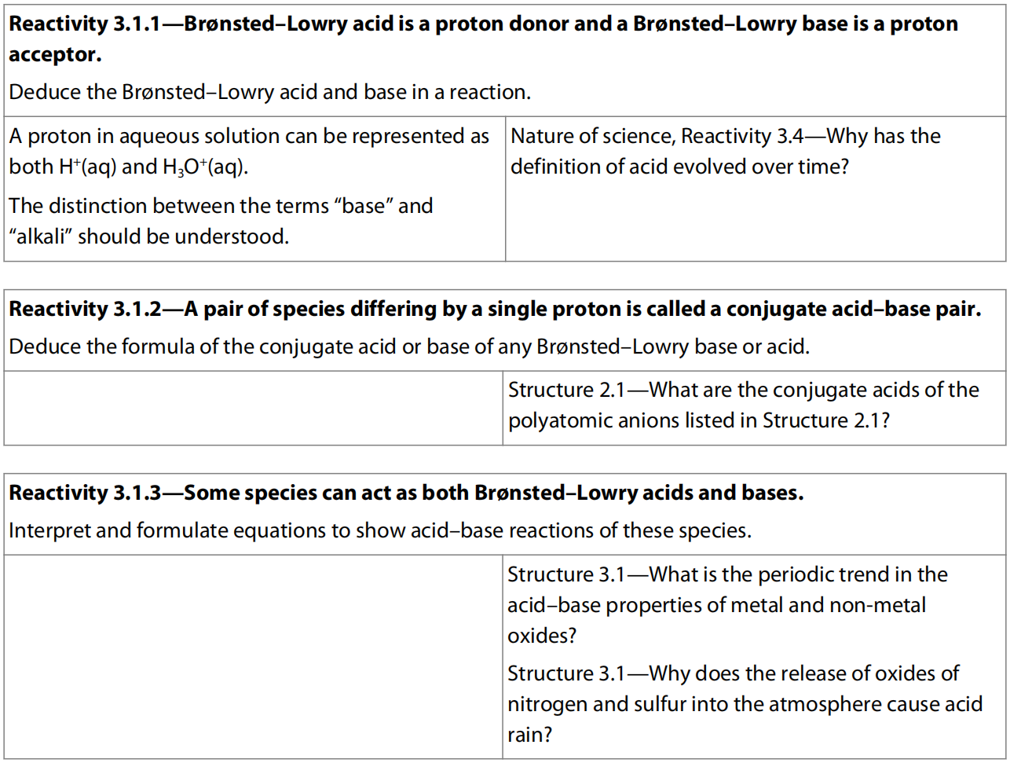
11.1 Bronsted-Lowry acids and bases

Slide 3
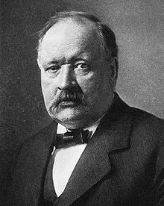
Arrhenius Acid-Base Theory
As defined by Arrhenius:
An Arrhenius acid is a substance that dissociate in water to form hydrogen ions (H⁺) and anions.
That is, an acid increases the concentration of H⁺ ions in an aqueous solution. This protonation of water yields hydronium ion (H₃O⁺), in modern times, the use of H⁺ is regarded as a shorthand for H₃O⁺, because it is now known that a bare proton (H⁺) does not exist as a free species in aqueous solution.
HCl → H⁺ + Cl⁻ or HCl + H₂O → H₃O⁺ + Cl⁻
H₂SO₄ → H⁺ + HSO₄⁻
or H₂SO₄ + H₂O → H₃O⁺ + HSO₄⁻
Svante Arrhenius (Sweden)
1903 Nobel Prize in Chemistry

Slide 4
Arrhenius Acid-Base Theory
As defined by Arrhenius:
An Arrhenius base is a substance that dissociates in water to form hydroxide (OH⁻) ions.
That is, a base increases the concentration of OH⁻ ions in an aqueous solution.
NaOH → Na⁺ + OH⁻
Ba(OH)₂ → Ba²⁺ + 2 OH⁻
Svante Arrhenius (Sweden)
1903 Nobel Prize in Chemistry

Slide 5
YOH (aq) →
OH⁻(aq)
+ Y⁺(aq)
In Arrhenius acid–base reactions, a salt and water are formed from the reaction between an acid and a base.This is a neutralization reaction which has been put into a word equation:
acid + base → salt + water
NaOH + HCl → NaCl + H₂O
Ca(OH)₂ + 2 HNO₃ → Ca(NO₃)₂ + 2 H₂O

Slide 6
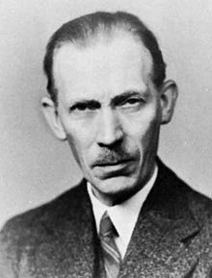
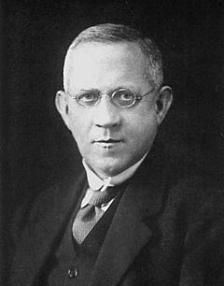
Brønsted–Lowry Acid-Base Theory (1923)
An acid is a species that acts as a donor of hydrogen ions (H⁺);
A hydrogen ion consists of just a proton, so acids are also often referred to as proton donors.
This extend the definition of acid to other solvent systems and to various ions.
HCO₃⁻, HSO₄⁻, H₂PO₄⁻, HPO₄²⁻, NH₃, H₂O, etc.
Johannes Brønsted (Denmark)
Martin Lowry (U.K.)

Slide 7
Brønsted–Lowry Acid-Base Theory (1923)
A base is a species that acts as an acceptor of hydrogen ions
(proton acceptor).
This extends the definition of a base that some species not containing any oxygen atoms can still act as a Brønsted-Lowry base, as well as some ions.
NH₃, OH⁻, PO₄³⁻, CH₃COO⁻, H₂PO₄⁻, HPO₄²⁻, HSO₄⁻, SO₄²⁻, CO₃²⁻, etc.
Johannes Brønsted (Denmark)
Martin Lowry (U.K.)

Slide 8
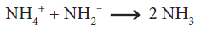
Unlike the previous definitions, the Brønsted–Lowry definition does not refer acid-base reaction to the formation of salt and solvent, but instead to the formation of conjugate acids and conjugate bases, produced by the transfer of a proton from the acid to the base.

Slide 9
The removal of a proton (hydrogen ion) from an acid produces its conjugate base, which is the acid with a hydrogen ion removed.
The reception of a proton by a base produces its conjugate acid, which is the base with a hydrogen ion added.
For example, the removal of H⁺ from hydrochloric acid (HCl) produces the chloride ion (Cl⁻), the conjugate base of the acid:
HCl → H⁺ + Cl⁻
The addition of H⁺ to the hydroxide ion (OH⁻), a base, produces water (H₂O), its conjugate acid:
H⁺ + OH⁻ → H₂O

Slide 10
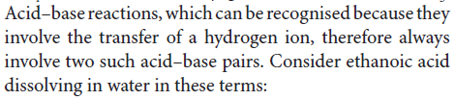

Slide 11
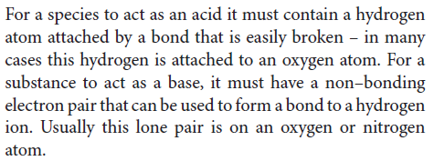

Slide 12
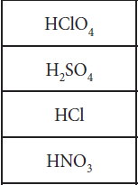
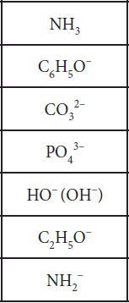
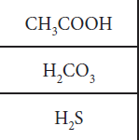
Find the conjugate base/acid for following species:

Slide 13
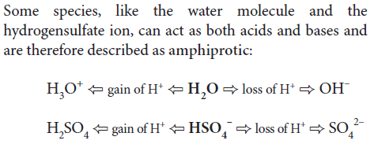

Slide 14
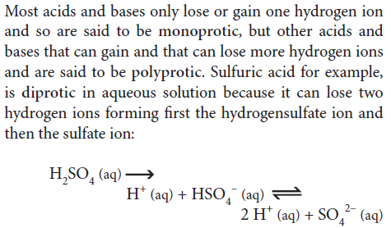

Slide 15
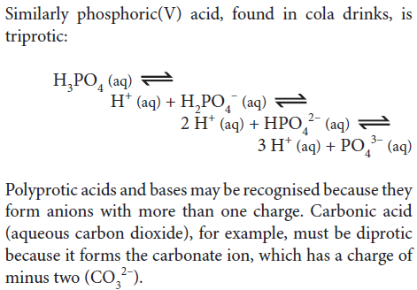

Slide 16
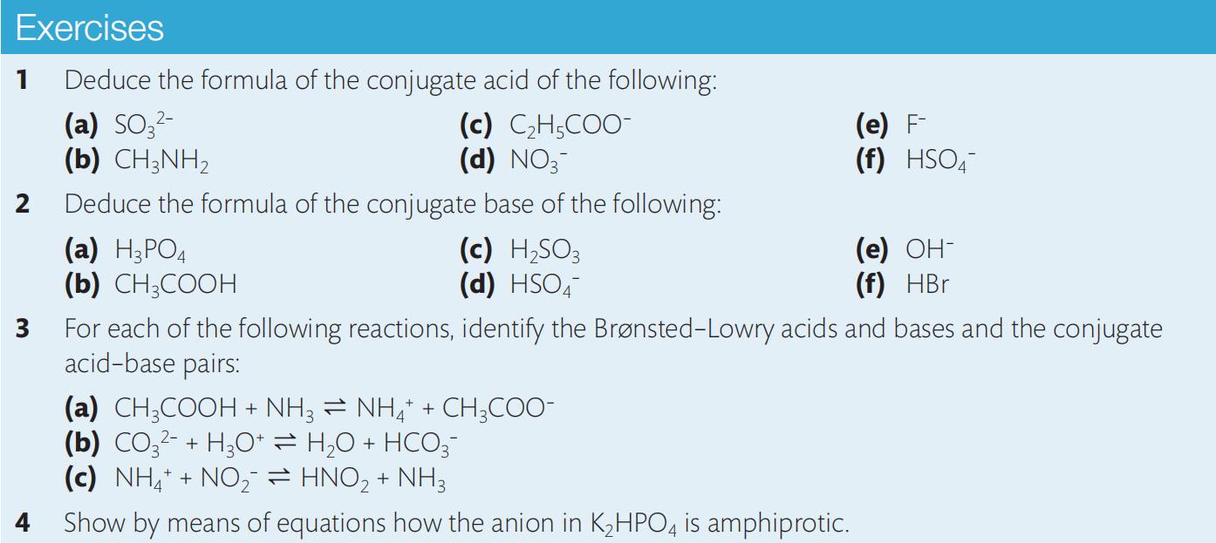
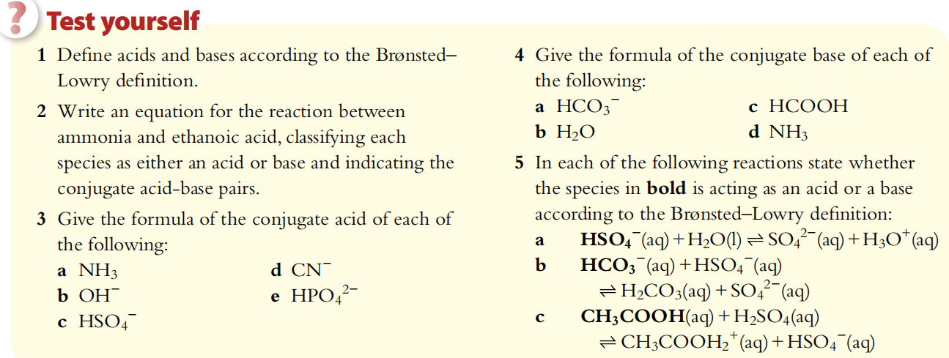

Slide 17
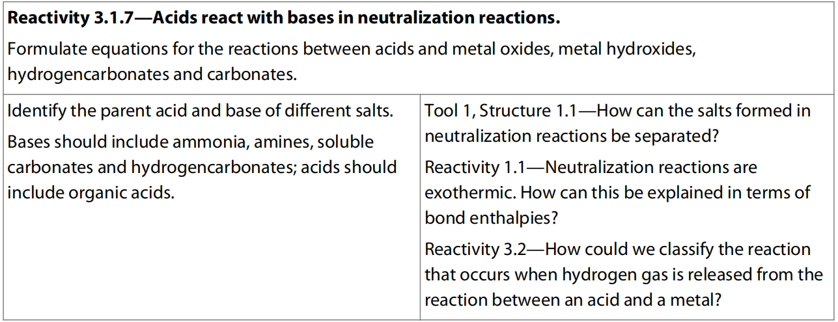
11.2 Gerneral properties of acids and bases

Slide 18
Characteristic properties of acid
React with indicators
React with base (neutralization)
React with reactive metals
(Stronger acid) react with carbonates (anions of weaker acids) to form CO₂ (weaker acids)

Slide 19
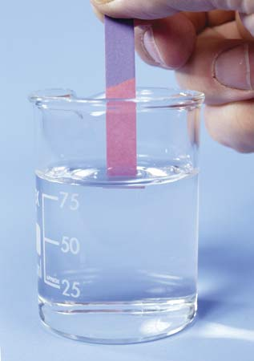
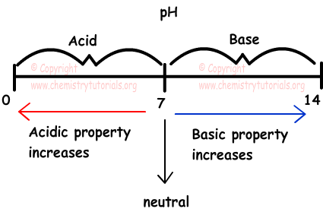
Characteristic properties of acid

Slide 21
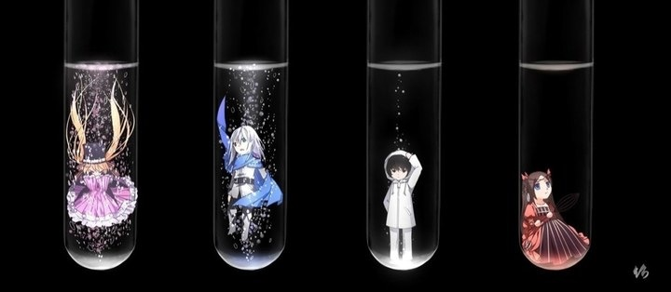
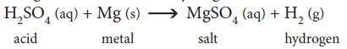
Characteristic properties of acid

Slide 22
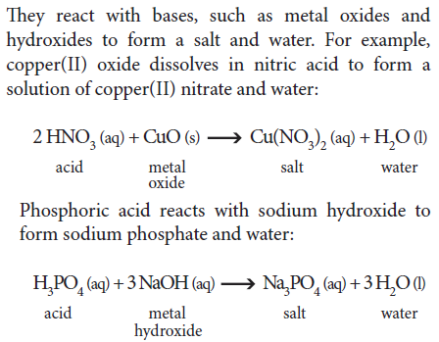
Characteristic properties of acid

Slide 23
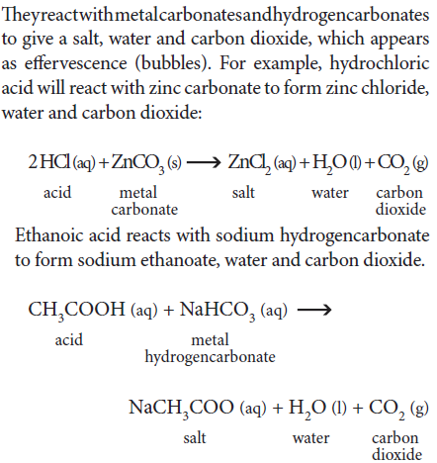

Slide 24
Characteristic properties of Base
React with indicators
React with acids (neutralization)
React with acidic oxides
(Stronger base) react with ammonium salt (weaker bases) to form ammonia (weaker bases)

Slide 25
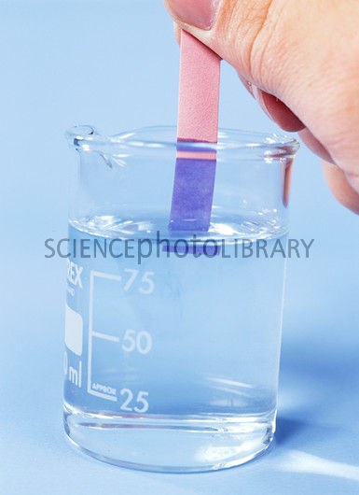
Characteristic properties of Base
Aqueous soluble bases are also called alkalis

Slide 26
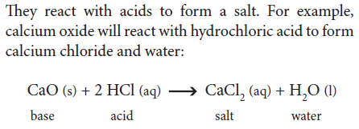
Characteristic properties of Base

Slide 27
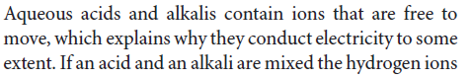
Conductivity

Slide 28
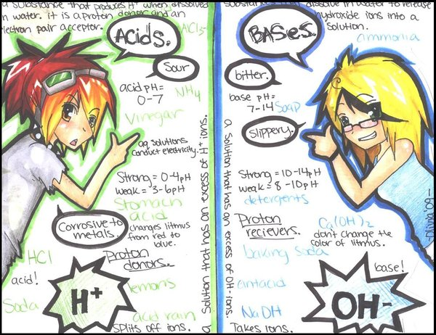

Slide 29
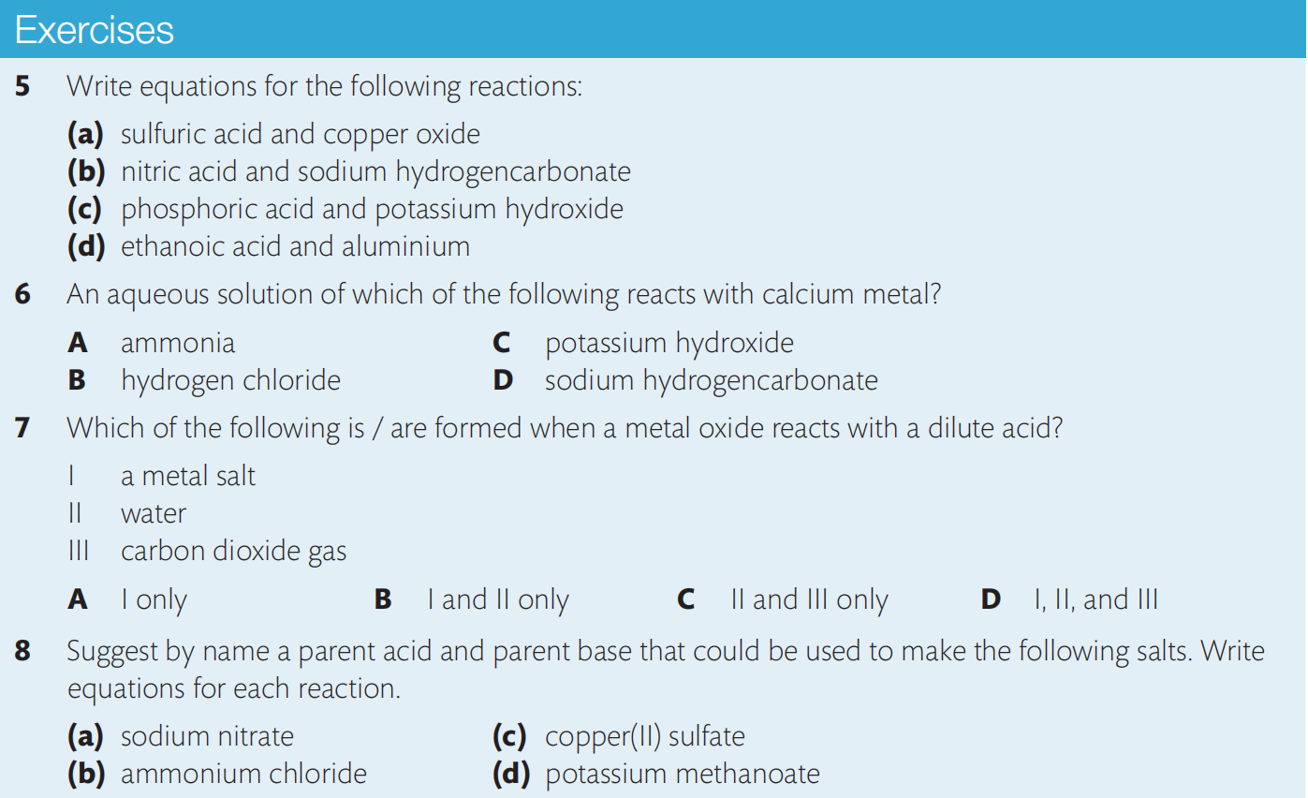
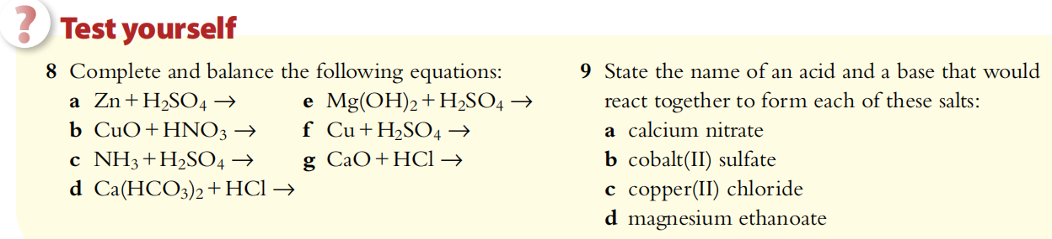

Slide 30
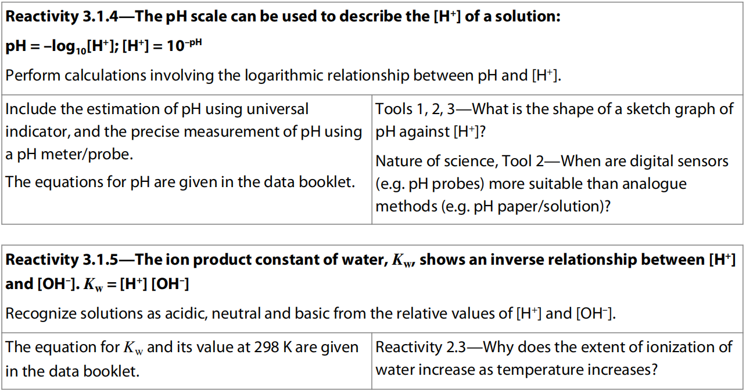
11.3 the Ph scale

Slide 31
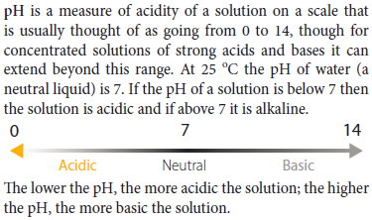

Slide 32
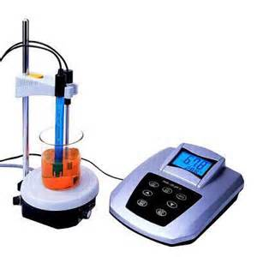
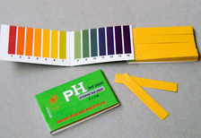
Determine the pH

Slide 33
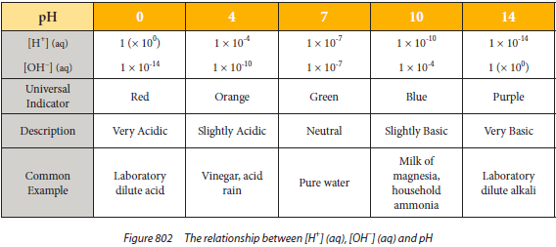
Determine the pH

Slide 35
pH is a logarithmic expression of [H⁺]

Slide 36
pH numbers are usually positive and have no units
Although the pH scale is theoretically an infinite scale (and can even extend into negative numbers), most acids and bases encountered will have positive pH values and fall within the range 0–14, corresponding to [H⁺] from 1.0 mol dm^{–3} to 10^{–14} mol dm^{–3}.

Slide 37
The pH number is inversely related to the [H⁺]
Solutions with a higher [H⁺] have a lower pH and vice versa. So stronger and more concentrated acids have a lower pH, weaker and more dilute acids have a higher pH.

Slide 38
A change of one pH unit represents a 10-fold change in [H⁺]
This means increasing the pH by one unit represents a decrease in [H⁺] by 10 times.
Decreasing by one pH unit represents an increase in [H⁺] by 10 times.

Slide 39
pH calculations
From the definition of pH we can:
(i) calculate the value of pH from a known [H⁺];
(ii) calculate the [H⁺] from a given pH.
The number of significant figure of [H⁺] equals to the number of decimal place of its pH value.
That is because the whole number part of pH value only shows the power of the [H⁺].

Slide 42
The ionization of water
As the majority of acid–base reactions involve ionization in aqueous solution, it is useful to consider the role of water in more detail.
Water itself does ionize, albeit only very slightly at normal temperatures and pressures, so we can write an equilibrium expression for this reaction.

Slide 43
The concentration of water can be considered to be constant due to the fact that so little of it ionizes, and it can therefore be combined with K_{c} to produce a modified equilibrium constant known as K_{w}.
K_{c} [H₂O]=[H⁺][OH⁻]
Therefore K_{w} = [H⁺][OH–]
K_{w} is known as the ionic product constant of water and has a fixed value at a specified temperature. At 298 K, K_{w} = 1.00 × 10^{–14}.
In pure water because [H⁺] = [OH–],
it follows that [H⁺]² = K_{w}
So, at 298 K, [H⁺] = 1.00 × 10^{–7} which gives pH = 7.000
This is consistent with the widely known value for the pH of water at room temperature.

Slide 44
The relationship between H⁺ and OH– is inverse
Because the product [H⁺] × [OH–] gives a constant value, it follows that the concentrations of these ions must have an inverse relationship.
In other words, in aqueous solutions the higher the concentration of H⁺ the lower the concentration of OH–.
Solutions are defined as acidic, neutral, or basic according to their relative concentrations of these ions as shown below.

Slide 45
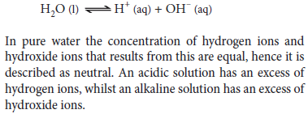
Why the pH is high for alkalis?
Le Chatelier’s principle

Slide 46
Definition of neutral?
What about pH smaller than 0 and bigger than 14?
Exist or not?

Slide 49
K_{w} is temperature dependent
K_{w} = [H⁺][OH–] = 1.00 × 10^{–14} at 298 K
As K_{w} is an equilibrium constant, its value must be temperature dependent.
The reaction for the dissociation of water is endothermic (it involves bond breaking) and so, as we learned before, an increase in temperature will shift the equilibrium to the right and increase the value of K_{w}.
This represents an increase in the concentrations of H⁺(aq) and OH–(aq), and so a decrease in pH.
Conversely, a reduction in temperature, through its effect on shifting the equilibrium to the left, decreases the value of Kw, representing lower ion concentrations and so higher pH values.

Slide 51
In other words, the pH of pure water is 7.00 only when the temperature is 298 K.
Note that at temperatures above and below this, despite changes in the pH value, water is still a neutral substance as its H⁺(aq) concentration is equal to its OH–(aq) concentration.
It does not become acidic or basic as we heat it and cool it respectively!
The temperature dependence of K_{w} means that the temperature should always be stated alongside pH measurements.

Slide 52
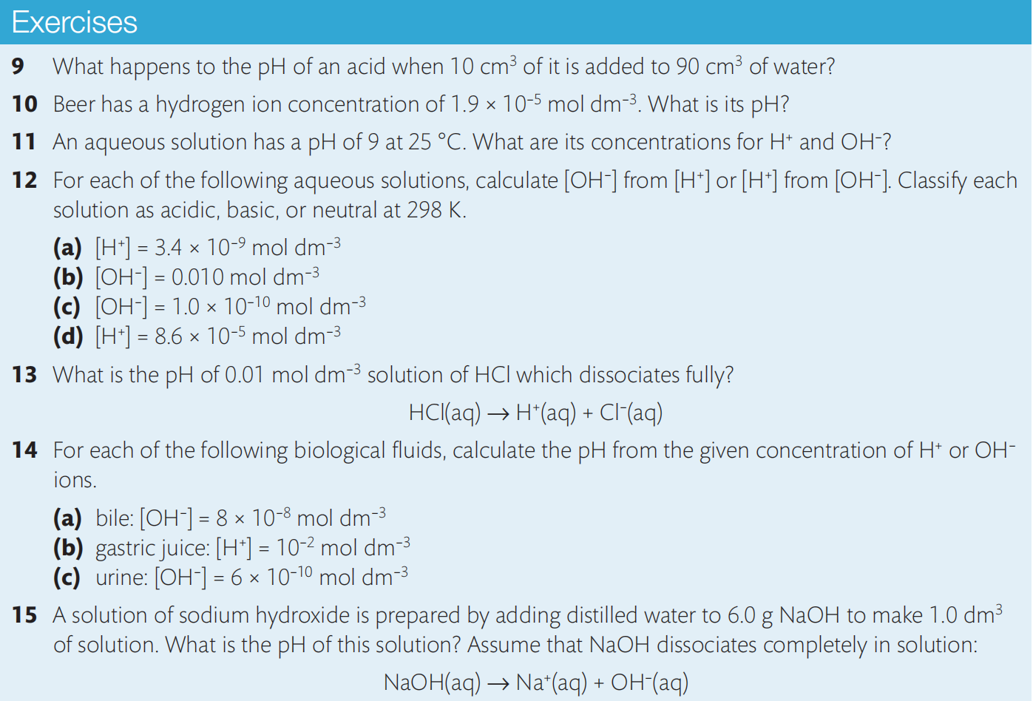

Slide 53
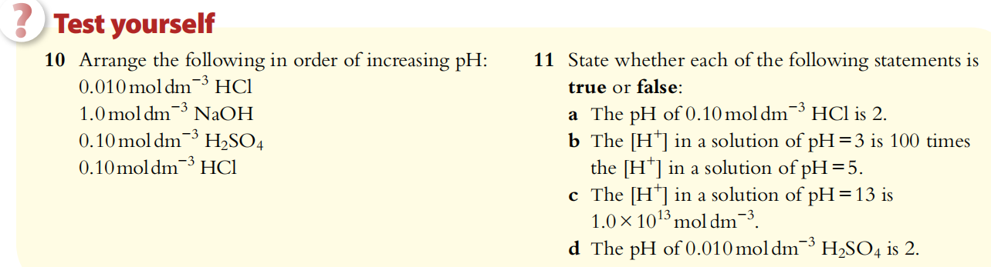
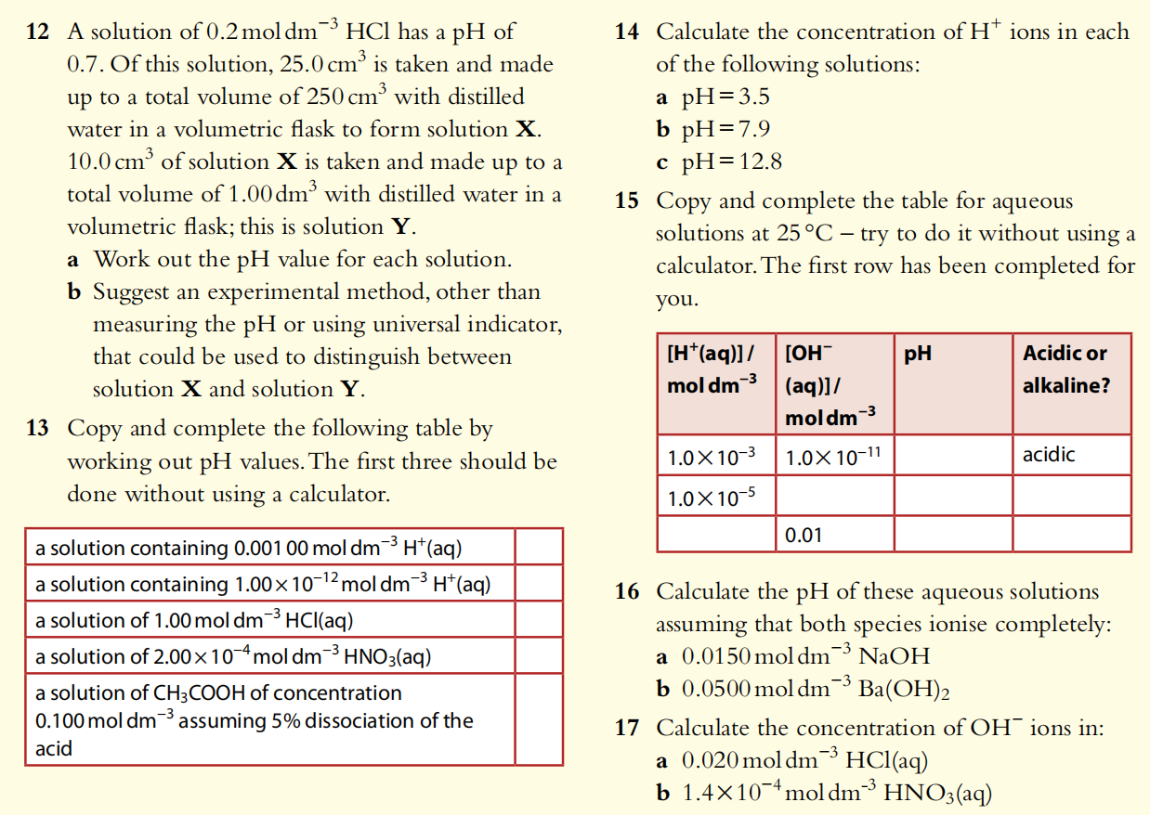

Slide 54
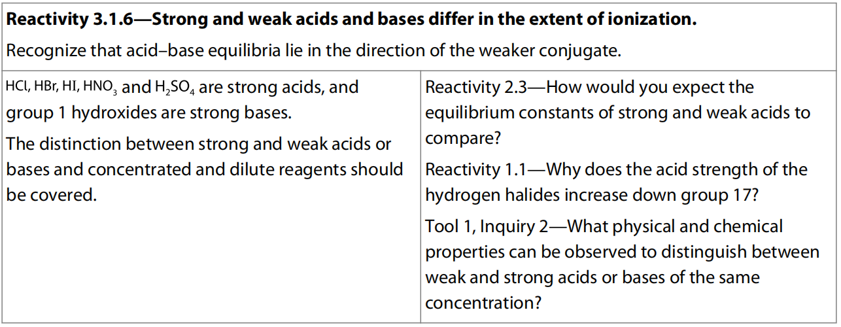
11.4 Strong and weak acids and bases

Slide 55
Who is stronger ?
H₂SO₄
H₂CO₃
1 M
1 M
0.001 M
1 M

Slide 56
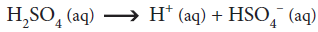
Who is stronger ?
H₂SO₄
H₂CO₃

Slide 57
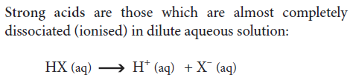
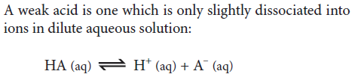
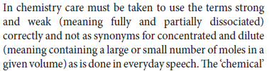
Extent of dissociation determines
( )

Slide 58
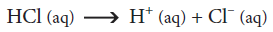
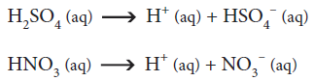
Common strong and weak acids

Slide 59
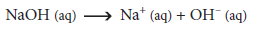
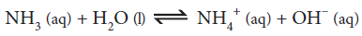
Common strong and weak bases

Slide 60
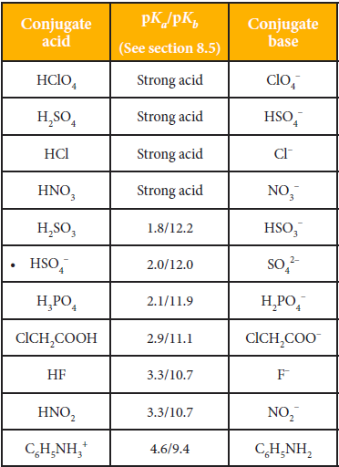
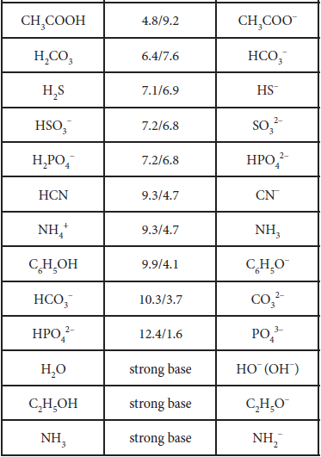

Slide 61
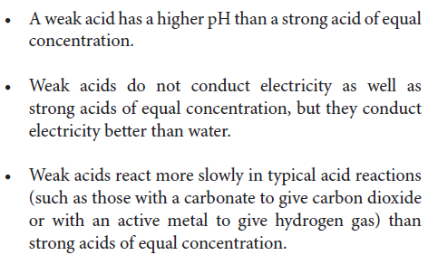
Distinguish strong and weak by experiment?

Slide 62
Distinguish strong & weak by formula
Atomic size:
H₂O , H₂S
HF, HCl, HBr, HI
Electronegativity:
H₃PO₄, H₂SO₄
HNO₃, HNO₂

Slide 63
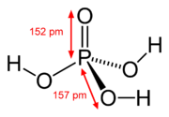

Distinguish strong & weak by formula
H₃PO₄, H₂SO₄
Inductive effect of P and S
As the electron density on hydrogen decreases it is more easily abstracted

Slide 64


Distinguish strong & weak by formula
HNO₃, HNO₂

Slide 65

electrolyte
The term electrolyte means forming ions in aqueous solution allowing it to conduct electricity

Slide 66

11.5 ph curve of strong acid-base titration

Slide 67
Acid-Base Titration curve
The unknown concentration of an acid or base in a solution can be determined by titration using a standard solution of a base or acid, respectively.
The reaction progress can be monitored using a digital pH meter and a data logger, which automatically records the pH of the reaction mixture as the standard solution is added to the analysed solution.
The pH data collected during a titration experiment can be plotted against the added volume of the standard solution, producing a pH curve.
The overall shape of the pH curve depends on the strengths and concentrations of the reactants and on the addition order.

Slide 68

strong Acid titrated by strong base

Slide 69
Intercept to y-axis
When a strong acid, such as HCl, is titrated with a strong base, such as NaOH, the curve intercepts the y-axis at a low pH value, as the analyzed solution is strongly acidic.
Typical concentrations of acids and bases used in titration experiments are from 0.01 to 1 mol dm⁻³, so the initial pH may vary from 2 to 0.

Slide 70
Starting part of the curve
At the beginning of the titration, the pH of the mixture increases very slowly, as the solution still contains large excess of acid and the pH is the negative common logarithm of [H⁺] rather than [H⁺] itself.
For example, if the initial concentration of the acid were 0.10 mol dm⁻³ and half of the acid were neutralized, [H⁺] in the mixed solution would be (0.1/2)×(V/1.5V) = 0.033 mol dm⁻³, and the pH of the mixture would increase from 1.00 to approximately 1.48.

Slide 71
ph Jump part of the curve
As the acid concentration decreases, the pH curve becomes progressively steeper since the power (order of magnitude) of [H⁺] drops more and more sharply.
At the equivalence point, the pH raises sharply to 7.0, as the acid is neutralized completely, and the reaction mixture contains only NaCl(aq):
HCl(aq) + NaOH(aq) → NaCl(aq) + H₂O(l)
The pH continues to rise sharply immediately after the equivalence point, as an excess of NaOH(aq) makes the solution basic and the power of [H⁺] still drops quite sharply.

Slide 72
Excess part of the curve
When the excess of the titrant becomes very large, the curve flattens out and gradually approaches the pH of the standard NaOH(aq) solution, typically between 12 and 14.

Slide 73
To construct the complete pH curve, we need to continue the titration beyond the equivalence by adding excess titrant.
In contrast, a titration experiment with an acid–base indicator must be stopped at or near the equivalence point, when the indicator changes colour.
In both cases, the concentration of the analyzed acid or base is calculated using the volume of the standard solution at the equivalence point.

Slide 74
When a strong base is titrated with a strong acid, the pH curve is inverted. Since the initial solution is basic, the curve intercepts the y-axis at a high pH value and declines gradually as the titrant is added. The equivalence is achieved at the same pH value (7.0), as the solution at that point contains only a neutral salt (in our example, NaCl).
At the end of the titration, the curve flattens at a low pH, as the solution contains excess strong acid.

Slide 75


Slide 76

11.6 POh and PH calculation (HIGHER Level)

Slide 77
pH and pOH scales are inter-related
In section 8.3 we learned that the pH scale was introduced in order to simplify the expression of the H⁺ concentration in a solution, and in particular it helps us to compare different solutions in terms of their H⁺ content.
The same rationale can be applied to the OH– ions. Like H⁺ ions, OH– ions are often present in low concentrations in solutions and so have negative exponents when expressed as mol dm^{–3} that can be awkward to work with. The parallel scale, known as the pOH scale, is therefore used to describe the OH– content of solutions.
pH = –log₁₀[H⁺]; [H⁺] = 10^{–pH}
pOH = –log₁₀[OH–]; [OH–] = 10^{–pOH}

Slide 80
Summary of the relationships between [H⁺], [OH–], pH, and pOH

Slide 82
Strong acids and bases: pH and pOH can be deduced from their concentrations
We assume full dissociation for strong acids and bases. Because of this we can deduce the ion concentrations and so calculate the pH or pOH directly from the initial concentration of the solution.
Note that the pH and pOH are derived from the equilibrium concentrations of H⁺ and OH–.

Slide 84


Slide 85



Slide 86



11.7 Weak acids and bases calculation (Higher Level)

Slide 87
Dissociation constants express the strength of weak acids and bases
Weak acids and bases, unlike strong acids and bases, do not dissociate fully.
This means we cannot deduce the concentrations of ions in their solutions from the initial concentrations, as the ion concentrations will depend on the extent of dissociation that has occurred.
The dissociation reactions of weak acids and weak bases can be represented as equilibrium expressions, each with their own equilibrium constant.
The value of this constant will convey information about the position of equilibrium, and therefore on the extent of dissociation of the acid or base.

Slide 88
Acid Dissociation Constant
Given that the concentration of water is considered to be a constant, we can combine this with K_{c} to produce a modified equilibrium constant known as K_{a}.
K_{a} is called the acid dissociation constant. It will have a fixed value for a particular acid at a specified temperature.

Slide 89
As the value of K_{a} depends on the position of the equilibrium of acid dissociation, it gives a direct measure of the strength of an acid.
The higher the value of K_{a} at a particular temperature, the greater the dissociation, and so the stronger the acid.
Note that because K_{a} is an equilibrium constant, its value does not depend on the concentration of the acid or on the presence of other ions.

Slide 90
Base Dissociation constant
Again we can combine the constants to give a modified equilibrium constant K_{b}.
K_{b} is called the base dissociation constant. It will have a fixed value for a particular base at a specified temperature.

Slide 91
As with K_{a}, the value of K_{b} relates to the position of the equilibrium and so in this case to the strength of the base.
The higher the value of K_{b} at a particular temperature, the greater the ionization and so the stronger the base.

Slide 93
Calculations involving K_{a} and K_{b}
The values of K_{a} and K_{b} enable us to compare the strengths of weak acids and bases, and also to calculate ion concentrations present at equilibrium and so the pH and pOH values.
The given concentration of an acid or base is its initial concentration – before dissociation occurs.
The pH (or pOH) of a solution refers to the concentration of H⁺ ions (or OH– ions) at equilibrium.
The concentration values substituted into the expressions for K_{a} and K_{b} must be the equilibrium values for all reactants and products.

Slide 94
x²/(0.75 – x) = 1.8 × 10⁻⁵
x² + 1.8 × 10⁻⁵ x – 0.75 × 1.8 × 10⁻⁵ = 0
x = 3.7 × 10⁻³ mol dm⁻³
pH = - log (3.7 × 10⁻³) = 2.43

Slide 99
Approximations been made in the calculations
K_{a} or K_{b} of weak acids and bases are usually small so that the equilibrium concentration of the weak acid or base molecule can be approximated to equal to its initial concentration.
K_{w} is even small so the dissociation of water is neglected so the initial concentration of H⁺ and OH⁻ are considered as 0.
BUT, are these approximations always valid??
NO!!

Slide 100
A 0.010 mol dm^{–3} solution of sulfurous acid has a value for K_{a1} = 1.20 × 10^{–2} at 298 K (K_{a2} = 6.17 × 10⁻⁸, which is too small compared with K_{a1}, so just ignore it). What is its pH at this temperature?
Simplified calculation (with approximation):
[H⁺] = √(K_{a1} × c) = √(1.20×10⁻² × 0.010) = 1.10×10⁻² mol dm⁻³
pH = - log (1.10×10⁻²) = 1.960
Normal calculation (without approximation):
x²/(0.010 - x) = 1.20×10⁻²
x² + 1.20×10⁻² x – 0.010 × 1.20×10⁻² = 0
x = 6.49×10⁻³ mol dm⁻³
pH = -log(6.49×10⁻³) = 2.188
Percentage error = |1.960-2.188|/2.188 = 10% > 5%
Since Ka₁ of H₂SO₃ is quite high and the initial concentration of H₂SO₃ is not high enough, initial concentration of H₂SO₃ molecule does NOT equal to equilibrium concentration in this case!!

Slide 101
Conditions for using the assumptions
Only when the extent of dissociation is very small, i.e. very low value for K_{a} or K_{b}, and relatively high initial concentration of acid, so [acid]_{initial} / K_{a} ≥ 500 (mostly if K_{a} is smaller than 1×10⁻³ it works since most of case the initial concentration of the acid would not be too low), it is appropriate to use the approximations:
[acid]_{initial} ≈ [acid]_{equilibrium}
[base]_{initial} ≈ [base]_{equilibrium}
Actually in IB syllabus, the assumptions can be applied in all the relevant calculations.

Slide 102



Slide 103


Slide 104
pK_{a} and pK_{b}
K_{a} and K_{b} values give us a direct measure of the relative strengths of weak acids and bases.
But as these values are characteristically very small, they usually involve dealing with numbers with negative exponents.
So, in the same way as with the concentrations of H⁺ and OH– ions and Kw, and for the same reason, we can convert K_{a} and K_{b} values into their negative logarithms to the base 10, known as pK_{a} and pK_{b}.

Slide 105
Some examples of K_{a} and pK_{a}, K_{b} and pK_{b} values are given below, all at 298 K.

Slide 106


Slide 107
pK_{a} and pK_{b} numbers are usually positive and have no units.
The relationship between K_{a} and pK_{a} and between K_{b} and pK_{b} is inverse.
A change of one unit in pK_{a} or pK_{b} represents a 10 fold change in the value of K_{a} or K_{b}.
pK_{a} and pK_{b} must be quoted at a specified temperature.
Table 21 in the IB data booklet gives pKa and pKb values for a range of common weak acids and bases.

Slide 108
Relationship between K_{a} and K_{b}, pK_{a} and pK_{b} for a conjugate pair
Consider the Ka and Kb expressions for a conjugate acid–base pair HA and A–.

Slide 110
This relationship holds for any conjugate acid–base pair in aqueous solution, so from the value of K_{a} of the acid we can calculate K_{b} for its conjugate base.
It shows that the higher the value of K_{a} for the acid, the lower the value of K_{b} for its conjugate base.
In other words, stronger acids have weaker conjugate bases, and vice versa.

Slide 111


Slide 112


Slide 113
Salt hydrolysis
A neutralization reaction between an acid and a base produces a salt – an ionic compound containing a cation from the parent base and an anion from the parent acid.
The cation is the conjugate acid of the parent base and the anion is the conjugate base of the parent acid.
But although salts are the products of a neutralization reaction, they do not all form neutral aqueous solutions.
Their pH in solution depends on whether and to what extent their ions, which are conjugate acids and bases, react with water and hydrolyze it, releasing H⁺ or OH– ions.

Slide 114
Salt of strong acid and strong base – no hydrolysis
The reaction between a strong acid and a strong base forms a salt in which both the conjugate acid and the conjugate base are weak.
As a result there is virtually no hydrolysis of ions, and the pH is close to neutral.

Slide 115
Salt of weak acid and strong base – anion hydrolysis
The anion (A–) is a conjugate base of the parent acid.
When the acid is weak (e.g. CH₃COOH) this conjugate base is strong enough to cause hydrolysis:
The release of OH– causes the pH of the solution to increase.

Slide 116
Salt of strong acid and weak base – cation hydrolysis
The cation (M⁺) is a conjugate of the parent base.
When the base is weak and this conjugate is a non-metal (e.g. NH₄⁺), it is able to hydrolyze water:
The release of H⁺ causes the pH of the solution to decrease.

Slide 117
Salt of Weak acid and weak base – both ions hydrolysis
When a weak acid reacts with a weak base, they form a salt in which both the conjugates are relatively strong and carry out hydrolysis.
The pH of the solution therefore depends on the relative K_{a} and K_{b} values of the acids and bases involved.

Slide 119



Slide 120


Slide 121


11.8 Buffer Solutions (Higher Level)

Slide 122
Buffer solutions
Definition: A buffer solution is resistant to changes in pH on the addition of small amounts of acid or alkali.
To understand the importance of buffers, it is useful to see how added acid or alkali changes the pH of a non-buffered solution. This is shown below.

Slide 123
Note the volume added here is merely 0.1 cm³ – just a few drops.
Evidently, water is very vulnerable to significant fluctuations in its pH and this can have major impacts on chemical reactions in aqueous solutions.
However, biological systems are able to operate efficiently only within a narrow range of pH, principally because of the effect that pH change has on enzyme activity and so on all biochemical reactions.
These systems are therefore dependent on buffers, and mammalian blood is an excellent example of a complex natural buffer.
Ocean chemistry also includes effective buffer systems, which help to maintain the conditions suitable for life.
Many chemical processes such as electrophoresis and fermentation, the dyes industry, and calibration of instruments depend on effective buffering.

Slide 124
Ocean Acidification
Ocean water has a pH around 8–9, controlled by several buffer systems.
The carbonate and bicarbonate ions, existing in equilibrium: CO₃^{2–} + H⁺ HCO₃–, are crucial to the buffering action.
The ocean has the capacity to absorb huge amounts of CO₂ from the atmosphere, so acts as a CO₂ ‘sink’, which is very important in helping to alleviate the effects of increasing atmospheric CO₂.

Slide 125
But as CO₂ dissolves in the ocean, it makes the water more acidic, releasing H⁺ that shifts the equilibrium and reduces the concentration of CO₃^{2–}.
Coral reefs are directly affected by this, as they depend on the carbonate ion to build their structures, and have shown serious decline with decreasing carbonate levels.
Of potentially greater impact still is the fact that the decrease in pH of the water may set up a feedback loop, reducing the ocean’s buffering capacity and so diminish its ability to take up additional CO₂ from the atmosphere.
Many research scientists believe that ocean acidification is potentially the most serious of all predicted outcomes of increase in atmospheric CO₂.

Slide 126
Mechanism of buffer system Acidic buffers
Composition: weak acid & its salt formed from a strong alkali, E.g.: CH₃COOH & CH₃COONa
Existing Equilibria: CH₃COOH CH₃COO⁻ + H⁺
CH₃COONa → CH₃COO⁻ + Na⁺
Respond to addition of acid:
CH₃COO⁻ + H⁺ CH₃COOH
Respond to addition of base:
CH₃COOH + OH⁻ CH₃COO⁻ + H₂O

Slide 127
Mechanism of buffer system Basic buffers
Composition: weak base & its salt formed from a strong acid, E.g.: NH₃ & NH₄Cl
Existing Equilibria: NH₃ + H₂O NH₄⁺ + OH⁻
NH₄Cl → NH₄⁺ + Cl⁻
Respond to addition of acid:
NH₃ + H⁺ NH₄⁺
Respond to addition of base:
NH₄⁺ + OH⁻ NH₃ + H₂O
In summary, buffer solutions are a mixture containing both an acid and a base of a weak conjugate pair.
The buffer’s acid neutralizes added alkali, and the buffer’s base neutralizes added acid, and so pH change is resisted.

Slide 128
Making buffer solutions
The pH of a buffer is determined by the interactions of its components.
Specifically it depends on:
the pK_{a} or pK_{b} of its acid or base;
the ratio of the initial concentrations of acid and salt, or base and salt, used in its preparation.
Buffer solutions can be prepared by starting with an acid or base that has a pK_{a} or pK_{b} value as close as possible to the required pH or pOH of the buffer.
This is then either:
mixed with a solution of a salt containing its conjugate OR
partially neutralized by a strong base or acid
The neutralization reaction should ensure that approximately one half of the starting acid or base is converted into salt.

Slide 129


Slide 130


Slide 131
Ph calculation of buffer solutions
Molar ratio of the acid/base and salt
As the molar ratio of the acid/base and salt changes, the pH of the buffer solution will change correspondingly.
This can be calculated as follows:

Slide 132





Slide 133



Slide 134


Slide 135


Slide 136



Slide 137



Slide 138



Slide 139



Slide 140


Slide 141



Slide 142
Factors that can influence buffers
Dilution
K_{a} and K_{b} are equilibrium constants and so are not changed by dilution.
Dilution also does not change the ratio of acid or base to salt concentration, as both components will be decreased by the same amount.
Therefore diluting a buffer does not change its pH.
But, diluting a buffer does alter the amount of acid or base it can absorb without significant changes in pH – the so-called buffering capacity.
This depends on the molar concentrations of its components, so decreases as they are lowered by dilution.

Slide 143
Factors that can influence buffers
Temperature
As temperature affects the values of K_{a} and K_{b}, it does affect the pH of the buffer.
This is why a constant temperature should be maintained in all work involving buffers, such as calibration of pH meters.
Temperature fluctuations must also be minimized in many medical procedures such as blood transfusions, due to the effect on the buffers in the blood.

Slide 144



Slide 145


Slide 146


11.9 Acid-base Titration Curve (higher Level)

Slide 147
Acid–base titrations
The neutralization reactions between acids and bases described above can be investigated quantitatively using titration.
Controlled volumes of one reactant are added from a burette to a fixed volume of the other reactant that has been carefully measured using a pipette and placed in a conical flask.
The reaction between acid and base takes place in the ask until the equivalence point or stoichiometric point is reached, where they exactly neutralize each other.
An indicator or a pH meter are used to detect the exact volume needed to reach equivalence.

Slide 148
Addition of base from the burette to an acid in the conical flask containing phenolphthalein indicator.
As the neutralization reaction happens, the change in the pH of the reaction mixture causes a change in the colour of the indicator.
Drop-wise addition of the base ensures that an accurate measure of the equivalence point can be made.

Slide 149
PH Curves
When a base is added to an acid in the neutralization reaction, there is a change in pH as we would expect.
But this change does NOT show a linear relationship with the volume of base added, partly due to the logarithmic nature of the pH scale.
The easiest way to follow the reaction is to record pH using a pH meter or data-logging device as a function of volume of base added, and plot these values as pH curves.

Slide 150
It is found that in most titrations a big jump in pH occurs at equivalence, and this is known as the point of inflection.
The equivalence point occurs when stoichiometrically equivalent amounts of acid and base have reacted together.
The equivalence point is determined as being halfway up this jump.
At this point the solution contains salt and water only.

Slide 152
Strong acid and strong base
HCl(aq) + NaOH(aq) → NaCl(aq) + H2O(l)
pH at equivalence = 7 as neither ion hydrolyses appreciably.

Slide 154
The calculations in the table above are a sample to show the reasons for the shape of the pH curve.
In this example we assume full dissociation because these are strong acids and bases.
Note also that as the base is added to the acid, neutralization of some of the acid occurs, while excess acid remains – until equivalence where the amounts of acid and base have fully reacted.
After equivalence the mixture contains excess base.
As the volume changes during the addition, this must be taken into account in determining the concentrations.

Slide 155
1 initial pH = 1 (pH of strong acid);
2 pH changes only gradually until equivalence;
3 very sharp jump in pH at equivalence: from pH 3 to pH 11;
4 after equivalence the curve flattens out at a high value (pH of strong base).
5 pH at equivalence = 7.

Slide 156
Weak acid and strong base
CH₃COOH (aq) + NaOH (aq) CH₃COONa (aq) + H₂O (l)
pH at equivalence > 7 as the anion hydrolysis releases OH–.

Slide 157
1 initial pH fairly high (pH of weak acid);
2 pH stays relatively constant until equivalence – labelled as buffer region;
3 jump in pH at equivalence from about pH 7.0–11.0, which is not as much of a jump as for a strong acid–strong base titration;
4 after equivalence the curve flattens out at a high value (pH of strong base);
5 pH at equivalence is > 7.

Slide 158
The reaction mixture after addition of 25 cm³ of base is of particular interest.
It is labelled as the half-equivalence point in the graph as it represents where exactly half of the acid has been neutralized by base and converted into salt, while the other half of the acid in the flask remains unreacted. This mixture, having equal quantities of a weak acid and its salt, is therefore a buffer.
This explains why the pH in this region is shown to be relatively resistant to change in pH on the addition of small amounts of base and why it is labelled as the buffer region in the graph above.

Slide 159
The pH at the half-equivalence point gives us an easy way to calculate pK_{a}.
Because at this point [acid] = [salt], we can substitute these values into the equilibrium expression of the acid:
so if we assume that [acid] = [HA] and [salt] = [A–], then [HA] = [A–] and so we can cancel these terms in the equilibrium expression:
K_{a} = [H⁺] and pK_{a} = pH
We can read the pH at the half-equivalence point directly from the graph, and so deduce the pKa of the acid as shown.
Note that a parallel calculation of pKb can be done when a titration is carried out with acid added to base.

Slide 160


Slide 161
Strong acid and weak base
HCl (aq) + NH₃ (aq) NH₄Cl (aq)
pH at equivalence < 7 as cation hydrolysis releases H⁺.

Slide 162
1 initial pH =1 (strong acid);
2 pH is lower than 7 at equivalence;
3 jump in pH at equivalence from about pH 3.0–7.0;
4 after equivalence the curve flattens out and reach a buffer region at a fairly low pH (pH of weak base);
5 pH at equivalence is < 7.

Slide 163
Weak acid and weak base
CH₃COOH (aq) + NH₃ (aq) CH₃COONH₄ (aq)
pH at equivalence is difficult to define.

Slide 164
1 initial pH is fairly high (pH of weak acid);
2 addition of base causes the pH to rise steadily;
3 change in pH at the equivalence point is much less sharp than in the other titrations;
4 after equivalence the curve flattens out at a fairly low pH (pH of weak base).

Slide 165
This titration does not give a clearly defined equivalence point as there is no significant jump in pH to identify, due to several equilibria being involved.
For this combination of acid and base, it is better to use other techniques, such as conductimetric measurements, to determine the equivalence point.

Slide 166


Slide 167


Slide 168
Indicators
Acid–base Indicators are substances that change color reversibly according to the pH of the solution.
They therefore signal a change in pH by undergoing a distinct colour change.
Indicators are actually weak acids or weak bases in which the undissociated and dissociated forms have different colors.

Slide 169
By applying Le Chatelier’s principle, we can predict how this equilibrium will respond to a change in the pH of the medium.
Increasing [H⁺]: the equilibrium will shift to the left in favor of HIn.
Decreasing [H⁺]: the equilibrium will shift to the right in favor of In–.
In other words, at low pH color A will dominate and at higher pH color B will dominate.

Slide 170
E.g.: methyl orange is an indicator that is red when placed in a solution of acid such as HCl.
As an alkali is added and the pH increases, the
indicator changes to yellow.
We can show this in an equation using HMet to represent the weak acid and Met – to represent its conjugate base.

Slide 171
Indicators change color when the pH is equal to their pK_{a}
The change in color of methyl orange, called its change point or end-point, happens in the range pH 3.1–4.4.
This is determined by the acid dissociation constant:
At the point where the equilibrium is balanced between the acid and its conjugate base, that is where [In–] = [HIn], the indicator is exactly in the middle of its colour change. As these values cancel in the equation
the expression is simplified as K_{a} = [H⁺] or pK_{a} = pH.

Slide 172
At this point, the addition of a very small volume of acid or base will shift the equilibrium as described above, and so cause the indicator to change colour – this is its end-point.
We can see from the equation above that this occurs at the pH equal to the pKa of the indicator.
It follows that different indicators, having different pK_{a} values, will have different end-points and so will change colour at different pH values.
A selection of indicator end-points is given in section 22 of the IB data booklet.

Slide 173
Indicators can be used to signal the equivalence point in titrations
Because indicators give us a visible cue when pH changes, they can be used to identify the equivalence points in titrations, given that this is the place where the pH changes most dramatically.
An indicator will be effective in signaling the equivalence point of a titration when its end-point coincides with the pH at the equivalence point.
This means that different indicators must be used for different titrations, depending on the pH at the equivalence point.

Slide 174
The following steps will help you to choose an appropriate indicator for a particular titration:
Determine what combination of weak and strong acid and base are reacting together.
Deduce the pH of the salt solution at equivalence from the nature of the parent acid and base.
Choose an indicator with an end-point in the range of the equivalence point by consulting data tables.
For example, in the titration of a weak acid with a strong base the equivalence point occurs in the range pH 7–11.
An appropriate indicator would therefore be one whose end-point lies in this range, such as phenolphthalein (end-point range 8.2–10.0) as shown below.

Slide 177
Our eyes are able to identify the distinct colour of one form of an indicator (e.g. HIn) when the ratio of its concentration to that of the other form (In–) is about 10:1.
So for a transition to be observed from the colour of HIn to the colour of In– at the end-point, the ratio of these concentrations must change from 10:1 to 1:10.
This represents a range of two pH units. This is why there is a range of ±1 pH units on either side of the value of pKa at which the eye can definitely notice the colour change occurring.
This is given as the end-point range in the table.

Slide 178


Slide 179


